Slide 1
Week 6 - Trees
Microsoft Interview Coaching Program

Slide 2
Agenda
Announcements
TEBOW IT review of last week’s homework
Trees
Classroom problem:
This week’s homework

Slide 3
Announcements
We’ll be holding mock interviews during week 8 (and the week afterwards, to handle scheduling)
Opportunity to practice under the conditions of an actual interview and get feedback from us ☺
Duration: 1 hour

Slide 4
Policy Reminder
Students who fail to submit more than TWO homework assignments will be dropped from the program
Remember to @mention your coach and session-mates in Slack channel when you submit your pull requests

Slide 5
Homework Guidelines!
TEBOW IT your homework problem on paper/whiteboard
This is *exactly* what you will do in your real interviews
Time yourself to 45 min – so you know which step of TEBOW IT needs more practice
Save your work so far via pictures (Let’s call it paperwork)
Code your solution on your computer
Helps you understand any missed gaps in your solution (gaps should reduce with practice!)
Helps in sharing your code with your coaches through pull requests
You will follow TDD here as well - write unit tests first and then code
Submissions:
1. Pull request with your unit tests and code
2. Paperwork (you can attach it to your pull request)

Slide 6
TEBOW IT – IsPalindrome (Linked List Version)

Slide 7
IsPalindrome (LinkedList)
Implement a function to check if a linked list is a palindrome

Slide 8
T – Talk (/Listen/Clarify)
Question | Answer
How should I handle null input? | Throw an exception
What are my inputs? | Node pointer to the head of the Linked List
Do I need to create my own Node or LinkedList classes? | No
What should be returned? | True if the linked list is a palindrome, false if it’s not
What is the definition of a Node object? | public class Node { public char val; public Node next; }
Is the linked list limited to alphabetic characters? | No, any ASCII character is allowed
How should non-alphabetic characters be handled? Should they be ignored or do normal palindrome rules apply? (e.g. is “t#acocat” a valid palindrome?) | Normal palindrome rules apply, “t#acocat” is invalid, “t#acoca#t” is valid
Should the function be case-sensitive? (e.g. is “rAcecar” a valid palindrome?) | Case-sensitive, “rAcecar” is not a valid palindrome
Am I permitted to use additional data structures? | Yes

Slide 9
E – Examples (/Test/TDD)
Sample Input | Equivalence Class | Output
Null | Null | Throw exception
‘a’ | Single element | True
‘a’->’a’ | Simple (even) success | True
‘a’->’b’->’a’ | Simple (odd) success | True
‘a’->’b’ | Simple failure | False
‘#’->’?’->”#’ | Non-alphabetic success | True
‘#’->’?’->’?’->’1’ | Non-alphabetic failure | False
‘a’->’*’->’%’->’a’ | Partial match | False
‘N’->’o’->’O’->’n’ | Mix upper/lowercase | False

Slide 10
B – Brute Force
Create a new linked list that is the reverse of the original
Walk the lists at the same time, comparing the value of each node
If the value at each index is the same, return true, otherwise return false
Time Complexity: O(n)
Space Complexity: O(n)
Notes:
Time: O(n) for the first traversal/creating the reversed list,+ O(n) time to walk the two lists
Space: O(n) for the additional linked list

Slide 11
O - Optimize
Can we check if the linked list is a palindrome with a single traversal?
Can we perform the same check with less space?

Slide 12

O - Optimize
We only need to check if the front half of the list is equal to the reverse of the second half
Solution: use a stack to reverse the front half of the list
push
n
stack

Slide 13
O - Optimize
We only need to check if the front half of the list is equal to the reverse of the second half
Solution: use a stack to reverse the front half of the list
push
o
n
stack

Slide 14
O - Optimize
We only need to check if the front half of the list is equal to the reverse of the second half
Solution: use a stack to reverse the front half of the list
Compare second half of the list to the elements in the stack, popping as you traverse
pop
o
n
stack

Slide 15
O - Optimize
We only need to check if the front half of the list is equal to the reverse of the second half
Solution: use a stack to reverse the front half of the list
Compare second half of the list to the elements in the stack, popping as you traverse
pop
n
stack
Notes:
If the elements are ever unequal, return false. If you hit the end of the list, the list is a palindrome! Return true

Slide 16
O - Optimize
How do we know we’ve reached the middle of the list if we’re not given a size variable?

Slide 17
Toolbox
Slow pointer: walks the list one node at a time
Traversal: node = node.next;
Fast pointer: walks the list two elements at a time
Traversal: node = node.next.next;
When the fast runner reaches the end of the list, we know the slow pointer is at the middle

Slide 18
W – Walk Through
Setup
Throw an exception if the input is null
Walk fast and slow pointers
Set slow equal to slow.next
Set fast equal to fast.next.next
Check if fast pointer is null
If it is:
The list has an odd number of elements
Skip the middle element (pointed to by slow): slow = slow.next
If slow reaches the end of the list…
Create and initialize the stack to hold the reversed first half of the string
Create fast and slow pointers
Until fast reaches the end of the list
Push slow.val onto the stack
Walk slow to the end of the list
For each remaining node
Pop from the stack
Compare this value with the data at slow.val
If they’re different, return false
The linked list is a palindrome!
Return true

Slide 19
I - Implement

Slide 20
public static bool IsPalindrome(Node head) {
if (head == null) { throw new ArgumentNullException(); }
Node fast = head;
Node slow = head;
Stack<Char> stack = new Stack<Char>();
while (fast != null && fast.next != null) {
stack.Push(slow.val);
slow = slow.next;
fast = fast.next.next;
}
if (fast != null) {
slow = slow.next;
}
while (slow != null) {
char data = stack.Pop();
if (data != slow.val) {
return false;
}
slow = slow.next;
}
return true;
}

Slide 21
T - Test
See E - Examples slide

Slide 22
Trees!

Slide 23
Tree Basics
Has a root node
Each node has zero or more child nodes
A leaf is a node with no children
Cannot contain cycles

Slide 24
Trees in Interviews
Tend to be “trickier” problems
Searching a tree typically more difficult than searching a linearly organized data structure (e.g. array, linked list….)
Average vs. worst case runtime may differ widely – speak to both when applicable
Watch out for ambiguous details / faulty assumptions

Slide 25
Common Got’chas
Tree ≠ Binary Tree
Tree: can have nodes with any number of children
Binary tree: each node may have at most 2 children
Tree ≠ Balanced Tree
Balanced tree: for each node, the height of the left and right subtree vary by 1 or less
Balanced trees have guaranteed O(log n) time for search/insert, unbalanced trees do not
Binary tree ≠ binary search tree
BST is a binary tree where all left descendants <= n < all right descendants (or left < n <= right)
Some BSTs allow duplicates, some don’t

Slide 26
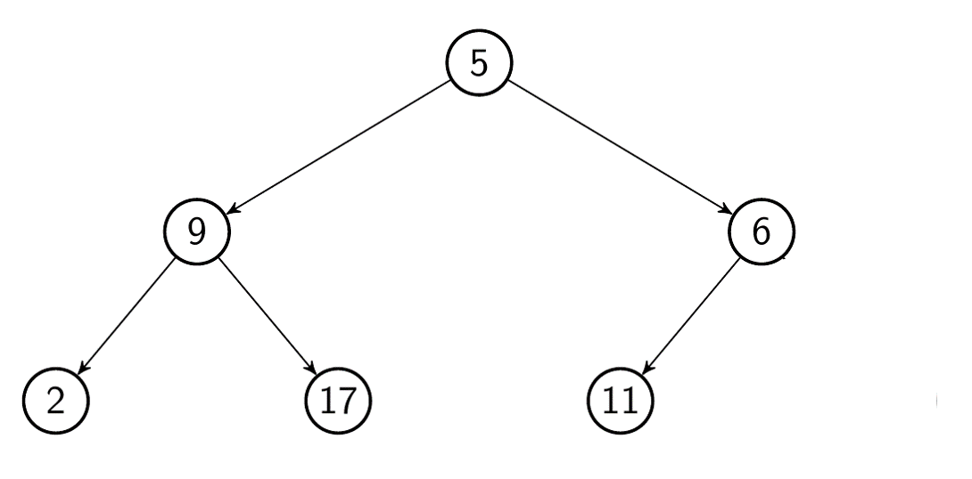
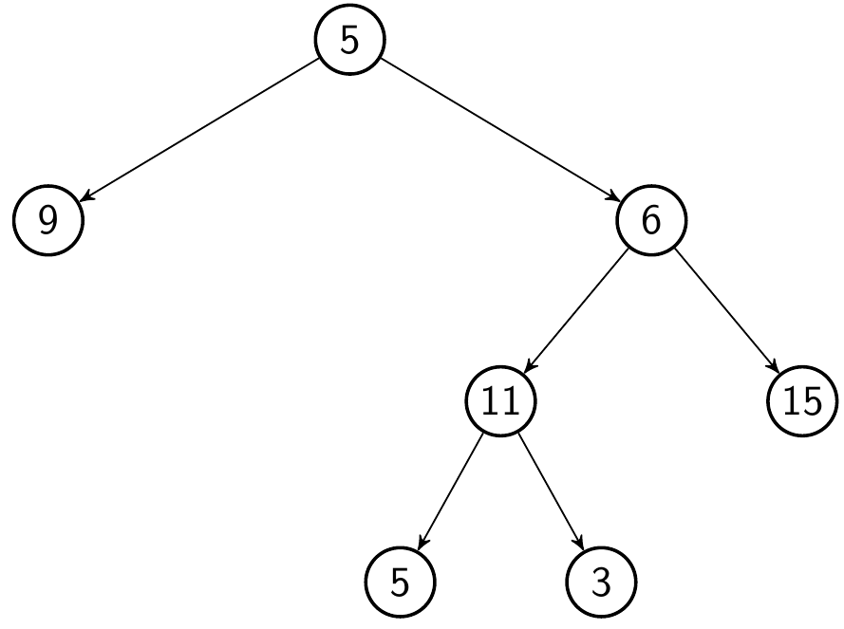
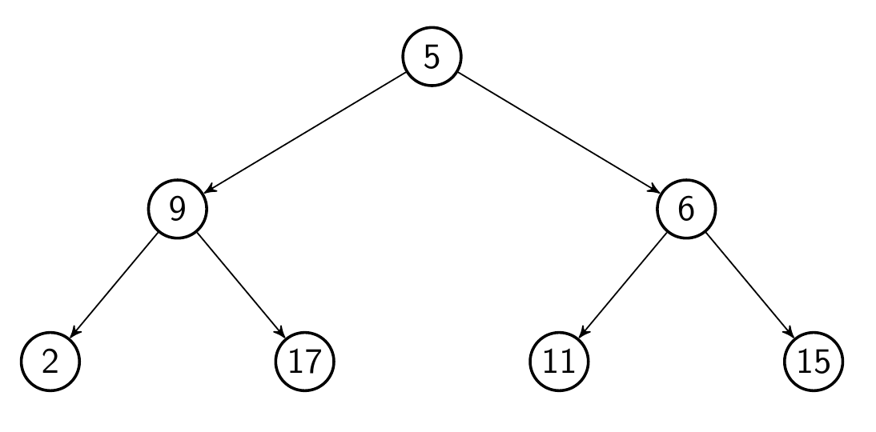
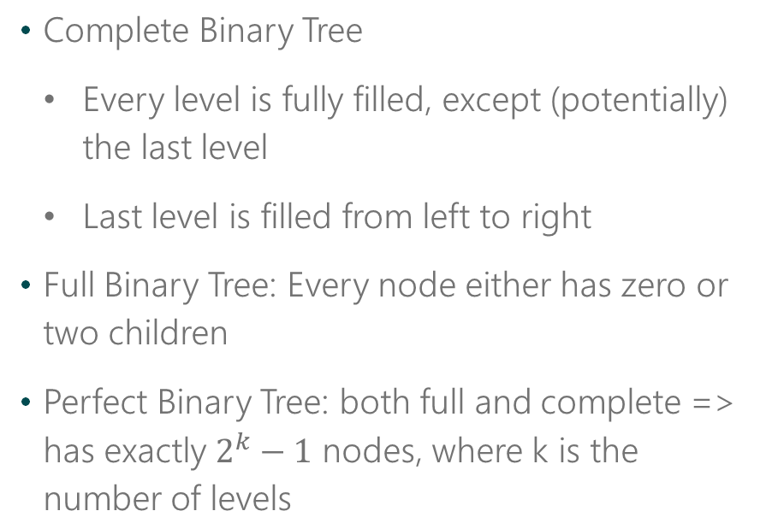
Common Terms
Complete Binary Tree
Every level is fully filled, except (potentially) the last level
Last level is filled from left to right
Full Binary Tree: Every node either has zero or two children
Perfect Binary Tree: both full and complete => has exactly $2^{k}−1$ nodes, where k is the number of levels

Slide 27
Don’t make assumptions about tree structure.
If the question is ambiguous, ask.

Slide 28
Toolbox
Binary tree traversals:
Simple Node implementation:
Pre-Order:
Visit current node
Visit left branch
Visit right Branch
In-Order
Visit left branch
Visit current node
Visit right branch
class Node {
public String name;
public Node[] children;
}
Post-Order:
Visit left branch
Visit right Branch
Visit current node

Slide 29
Time Complexity
Average Case
Worst Case
Type of Tree | Search | Insertion | Deletion | Search | Insertion | Deletion
Binary Search Tree | O(log(n)) | O(log(n)) | O(log(n)) | O(n) | O(n) | O(n)
Cartesian Tree | O(log(n)) | O(log(n)) | O(log(n)) | O(n) | O(n) | O(n)
B-Tree | O(log(n)) | O(log(n)) | O(log(n)) | O(log(n)) | O(log(n)) | O(log(n))
Red-Black Tree | O(log(n)) | O(log(n)) | O(log(n)) | O(log(n)) | O(log(n)) | O(log(n))
Splay Tree | O(log(n)) | O(log(n)) | O(log(n)) | O(log(n)) | O(log(n)) | O(log(n))
AVL Tree | O(log(n)) | O(log(n)) | O(log(n)) | O(log(n)) | O(log(n)) | O(log(n))
KD Tree | O(log(n)) | O(log(n)) | O(log(n)) | O(n) | O(n) | O(n)

Slide 30
Remember to draw pictures!

Slide 31
Classroom Problem -
Implement a function to check if a binary tree is balanced.

Slide 32
T – Talk (/Listen/Clarify)
Question | Answer
How should I handle null input? | Throw an exception
What are my inputs? | The root of the tree
Clarify definition of balanced (if you’re familiar with the term, verify with the interviewer that it means the same thing to both of you) | A tree is balanced if, for each node, the height of the node’s left and right subtrees are within 1 of each other
Do I need to create my own Node or Tree classes? | No
What should be returned? | True if the tree is balanced, false if it’s not
What is the definition of a Node object? | public class TreeNode { public int val; public TreeNode left; public TreeNode right; }
Am I permitted to use additional data structures? | Yes
Am I permitted to use recursion? | Yes

Slide 33

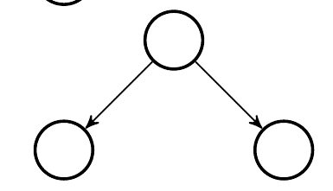
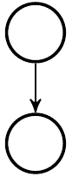
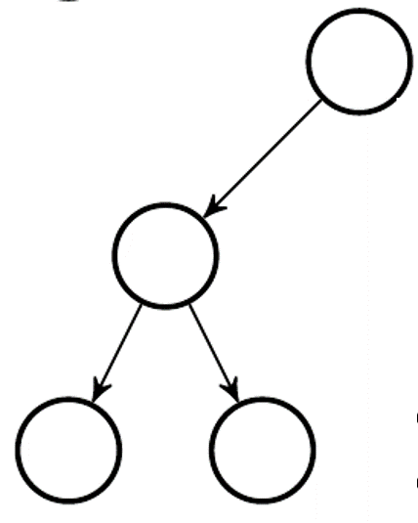
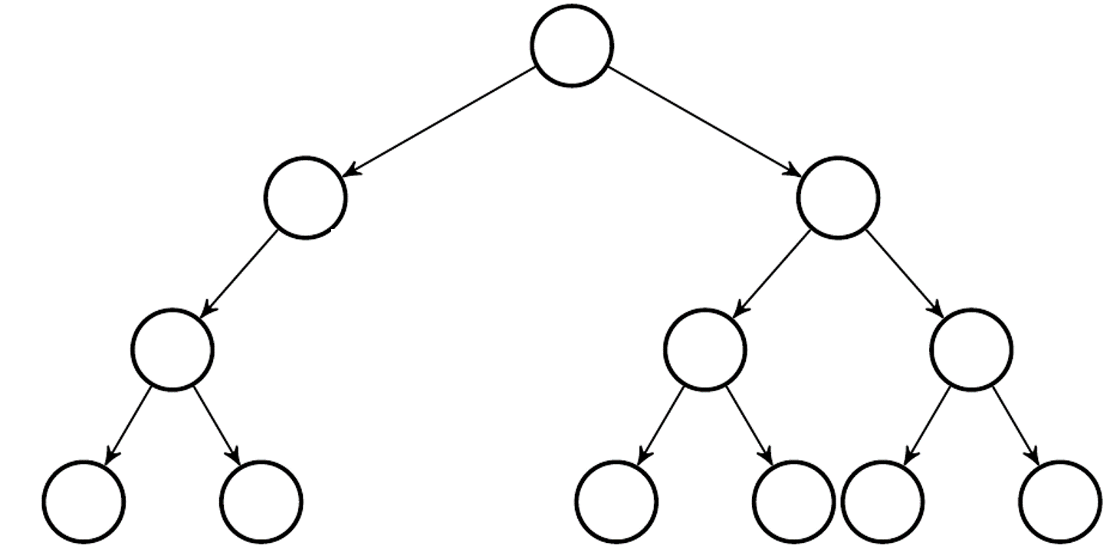
E – Examples (/Test/TDD)
Sample Input | Equivalence Class | Output
null | Null | Throw exception
 | Single element | True
 | Simple success | True
 | Height of subtrees not equal, but within one of each other | True
 | Simple failure | False
 | Unbalanced subtree not starting at root of original tree | False
Notes:
The last one is a good example because even though the height of each subtree from the root is the same, there are child nodes where the same is not true

Slide 34
B – Brute Force
Recurse through the tree
For each node:
If the current node is null (i.e. a leaf), return true
Compute the height of the left and right subtree
If the heights differ by more than one, return false
Recursive step: call the algorithm on the current node.left (lResult) and current node.right (rResult)
return lResult && rResult
Notes:
It helps to refer to the definition: “A tree is balanced if, for each node, the height of the node’s left and right subtrees are within 1 of each other”
Write a function to compute height for a node (subtree)
Write a function to check if a tree is balanced at th eroot level
(Recurse) check if the entire tree is balanced

Slide 35
public static int GetHeight(TreeNode curr)
{
if (curr == null)
{
return -1;
}
return Math.Max(GetHeight(curr.left), GetHeight(curr.right)) + 1;
}
public static bool IsBalanced(TreeNode curr)
{
if (curr == null)
{
return true;
}
if (Math.Abs(GetHeight(curr.left) - GetHeight(curr.right)) > 1)
{
return false;
} else
{
return IsBalanced(curr.left) && IsBalanced(curr.right);
}
}
Notes:
Remember that a tree with just a root node is considered having a height of 0

Slide 36
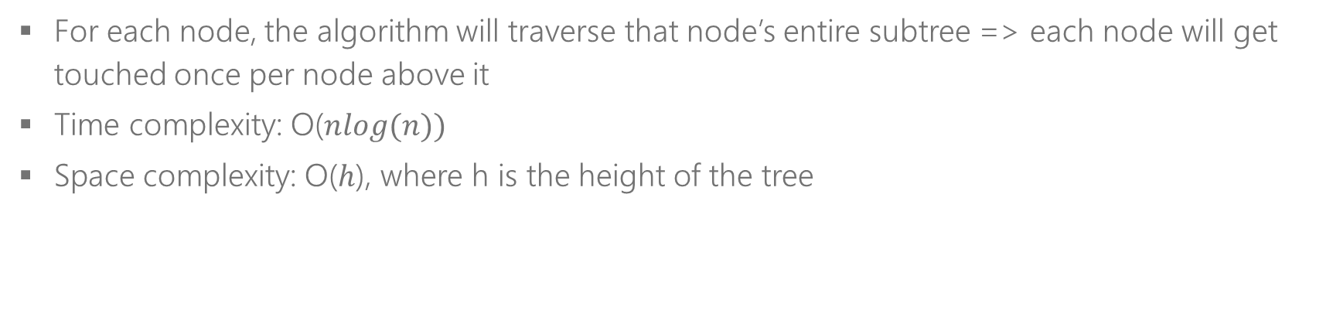
B – Brute Force (con’t)
For each node, the algorithm will traverse that node’s entire subtree => each node will get touched once per node above it
Time complexity: O($nlog(n))$
Space complexity: O($h$), where h is the height of the tree
Notes:
Space complexity is O(h) because h is the maximum recursive depth. There may have more recursive calls, but we pop off the stack each time the recursive call returns.

Slide 37

O - Optimize
Can we do better than O($nlog(n))$)?
Can we visit each node only once?

Slide 38
O - Optimize
Instead of calling GetHeight for the left and right child of each node and then checking the height difference, we can check height and balance at the same time!

Slide 39
O - Optimize
But wait… if we’re checking height/balance simultaneously as we recurse, how do we pass both pieces of information back to the caller?
Options:
Create a new class, struct, etc. that contains two pieces of info (int height & bool isBalanced)
Or: pass back an integer that represents an “error code” if the subtree is unbalanced

Slide 40
O - Optimize
We don’t care about height beyond checking that the left/right subtrees of each node are balanced, so the error code solution is better here because it requires less space
The trick is to make the error code a number that isn’t a possible height
By convention, the height of a leaf is -1, so any number smaller than that should suffice
To make it extra clear that the number we’re passing back is an invalid height, we’ll go with Integer.MIN_VALUE as our error code

Slide 41

O - Optimize
With the redundant work cut out, the Big O of our improved algorithm is as follows:
Time: O($n$)
Space: O($h$), the maximum recursive depth

Slide 42
W – Walk Through
Setup
If the root is null, throw an exception
Return boolean answer
Recursive function
Check the height of the left subtree, if it’s equal to Integer.MIN_VALUE, return Integer.MIN_VALUE
From the calling function, IsBalanced, evaluate the result of checkHeight(root)
Take the absolute value of the height of the left subtree – the height of the right subtree
Call function CheckHeight on the root of the tree
If the current node is null, return -1
Repeat the step above for the right subtree
If the value is greater than 1, return Integer.MIN_VALUE
Otherwise, return the max of the right subtree’s height and the left subtree’s height
If it’s equal to Integer.MIN_VALUE, return false
Otherwise, return true

Slide 43
I – Implement

Slide 44
public static Boolean IsBalanced(TreeNode root) {
return CheckHeight(root) != Int32.MinValue;
}
public static int CheckHeight(TreeNode curr) {
if (curr == null) {
return -1;
}
int leftHeight = CheckHeight(curr.left);
if (leftHeight == Int32.MinValue) {
return Int32.MinValue;
}
int rightHeight = CheckHeight(curr.right);
if (rightHeight == Int32.MinValue) {
return Int32.MinValue;
}
if (Math.Abs(leftHeight - rightHeight) > 1) {
return Int32.MinValue;
}
return Math.Max(leftHeight, rightHeight) + 1;
}

Slide 45
T - Test
See E - Examples slide

Slide 46
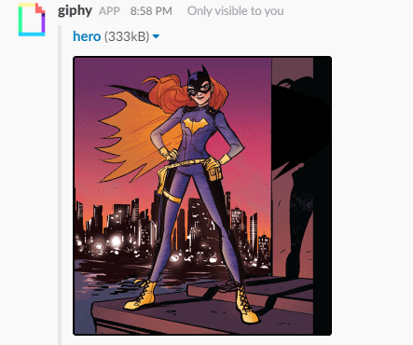
Be a hero – review code

Slide 47
Challenge Problems
Count the number of words in a Trie
Connect Nodes at the same level
Construct the full k-ary tree from its preorder traversal

Slide 48
Homework Problem
Subtree of Another Tree
Given two non-empty binary trees s and t, check whether tree t has exactly the same structure and node values with a subtree of s. A subtree of s is a tree that consists of a node in s and all of that node's descendants.

